Slide 1

MPIP code club Docker / CI workshop
Lucas Miranda, PhD candidate
Statistical Genetics
Prof. Dr. Bertram Mueller-Myhsok
lucas_miranda@psych.mpg.de
MPIP code club | 04.03.2021
Notes:
Introduce mathias and his group
"Neurobiology of stress resilience"
Particular interest in studying mice behaviour

Slide 2
Containers and continuous integration
How can I know if my code will run in another computer?
How do I make sure that I don‘t break anything when I change my code?

Slide 3
Summary
My code runs for me… why would I bother?
Open science and reproducibility
Proofreading / testing
Versatility / Futureproof
Containers (Docker)
What are they?
How do I build one?
Pros and cons for deployment (vs e.g plain binaries)
Continuous Integration
Setting up a testing pipeline on my remote
GitLab CI
Travis CI

Slide 4

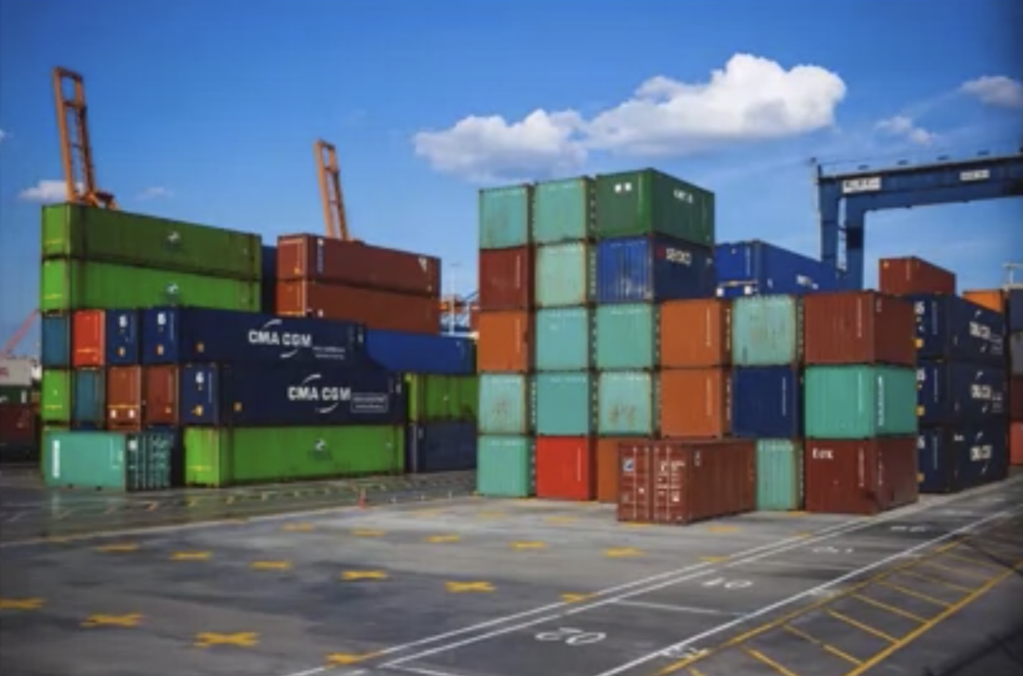
Containers

Slide 5
Containers
Executable units of software
With all you need to run
Can be run anywhere!
OS-level virtualization
Isolates processes
Controls resources allocated to those processes
Small, fast and portable
Don‘t include OS in every instance
Leverages host OS

Slide 6
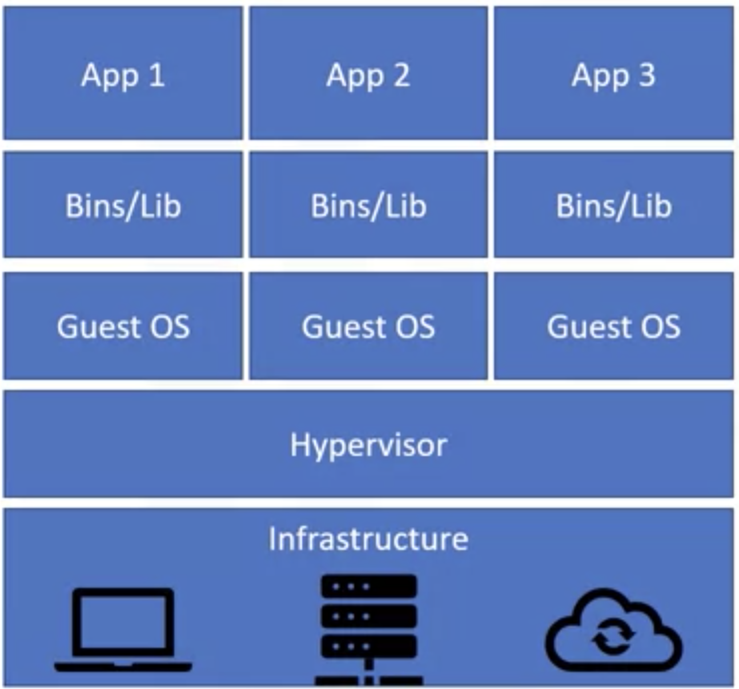
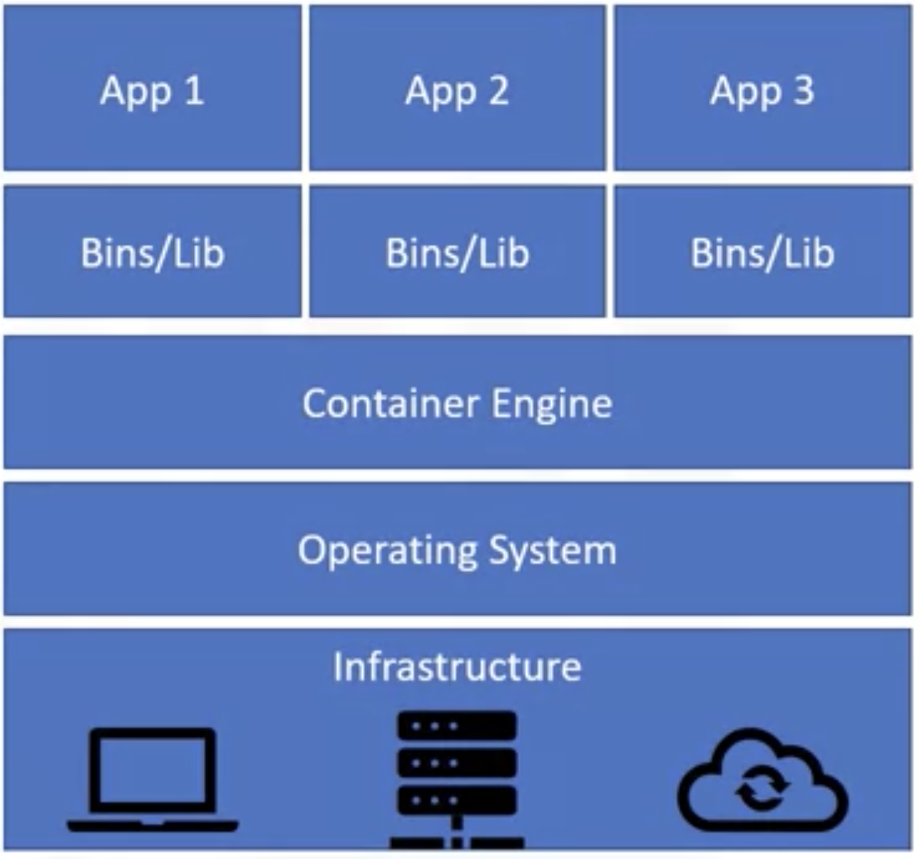
Containers
virtual machines
containers

Slide 7
Docker
Software platform for building / running containers
Not the only one! (rkt, LXD, etc).
Launched in 2013
Straightforward to use ☺
Open source!
Developed by an open community
Docker company provides enterprise software too
Registry
(Docker hub)
push
pull
Docker Image
Dockerfile
build
run
Docker container
Notes:
Image like class; container is like an instanciated object of that class

Slide 8
Docker CLI
docker build
docker tag
docker images
docker run
docker push/pull
Creates container images
Requires a Dockerfile
Tags (names) images
names images (lowercase)
list all image details
Runs a container
Test a built image
Interact with a registry

Slide 9
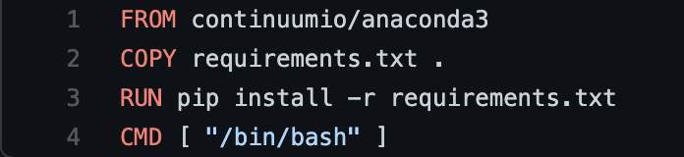
Dockerfile – building an image
docker build -t your_name/mpip_docker_workshop .
docker run your_name/mpip_docker_workshop
docker push your_name/mpip_docker_workshop

Slide 10
Deployment of an app – Container orchestration

Slide 11
A brief on testing
unit testing
property-based testing
coverage evaluation

Slide 12
Continuous integration
More versatile (works with GitLab, GitHub, Bitbucket, etc)
Easier to use (at least for me!)
Faster / more powerful (on the MPCDF servers)

Slide 13
Travis CI

Slide 14
GitLab CI

Slide 15

Thank you!

Slide 16
Version control
Why should I care if I‘m only running data analysis pipelines?
Open science
A comment on licenses

Slide 17
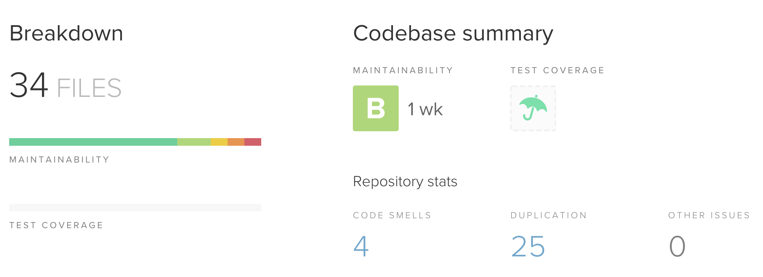
Code quality
Modular code
Maintainable code
Self-documented code

Slide 18
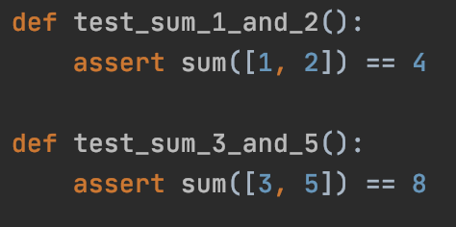
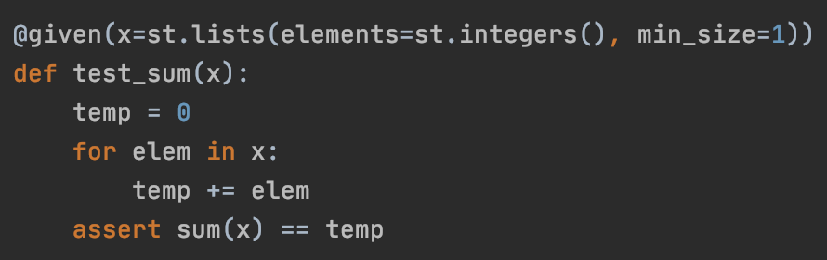
Testing
unit testing
property-based testing

